Slide 1
PORTFOLIO
Linda lai

Slide 2
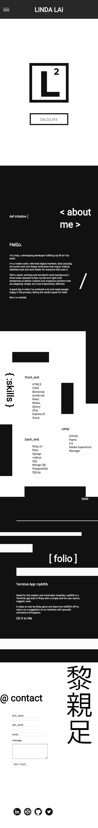
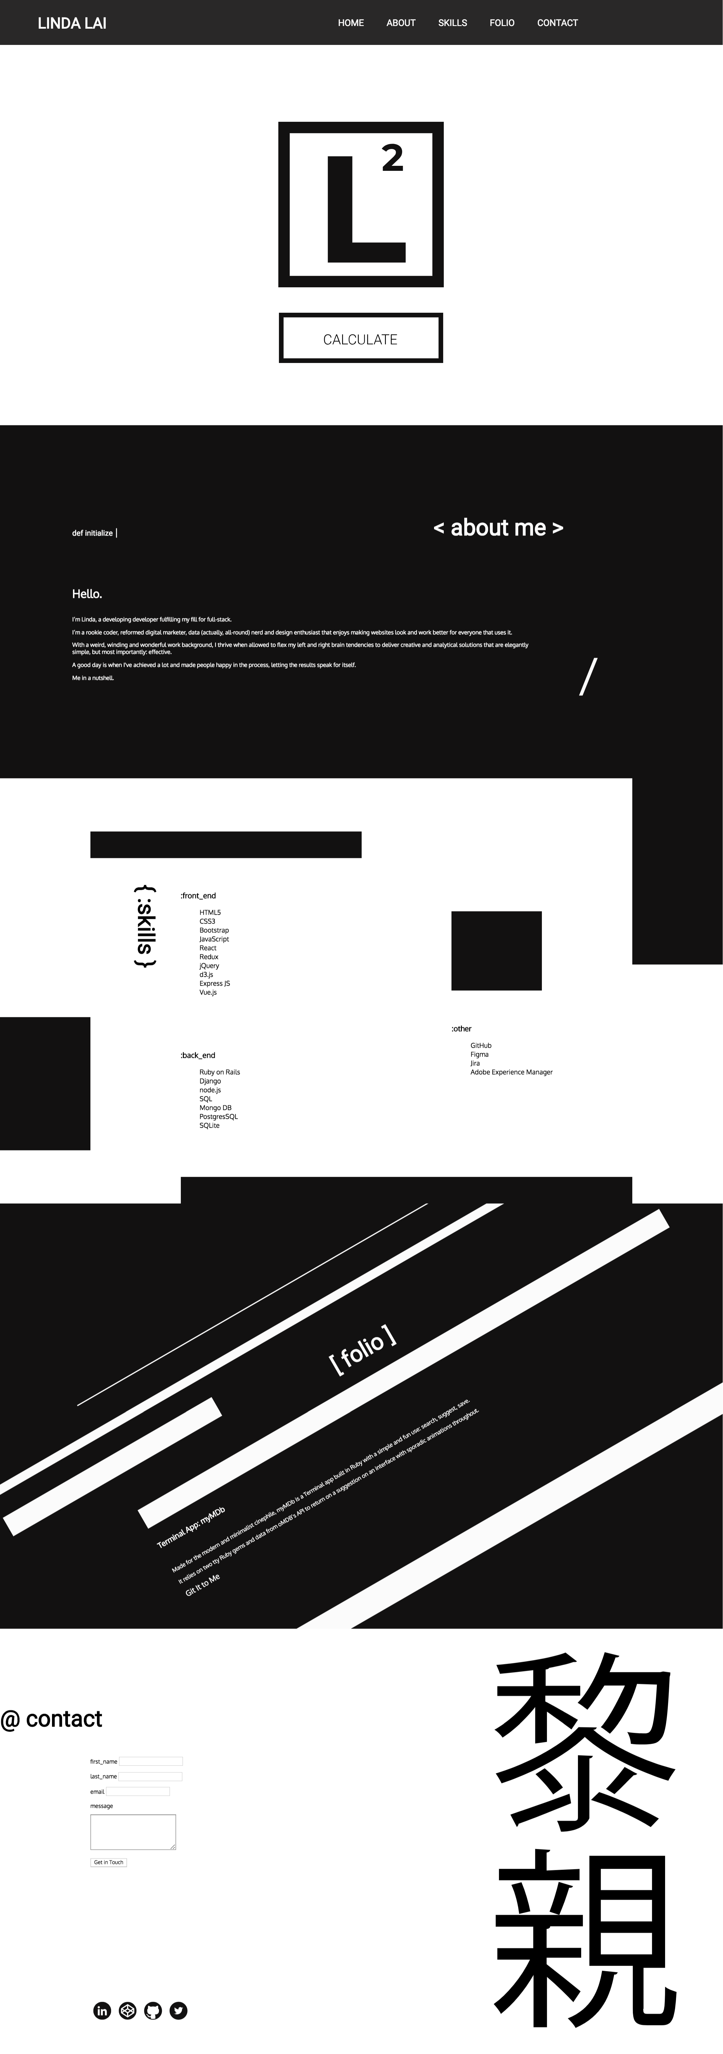
Demo
https://ladnil.github.io/

Slide 3
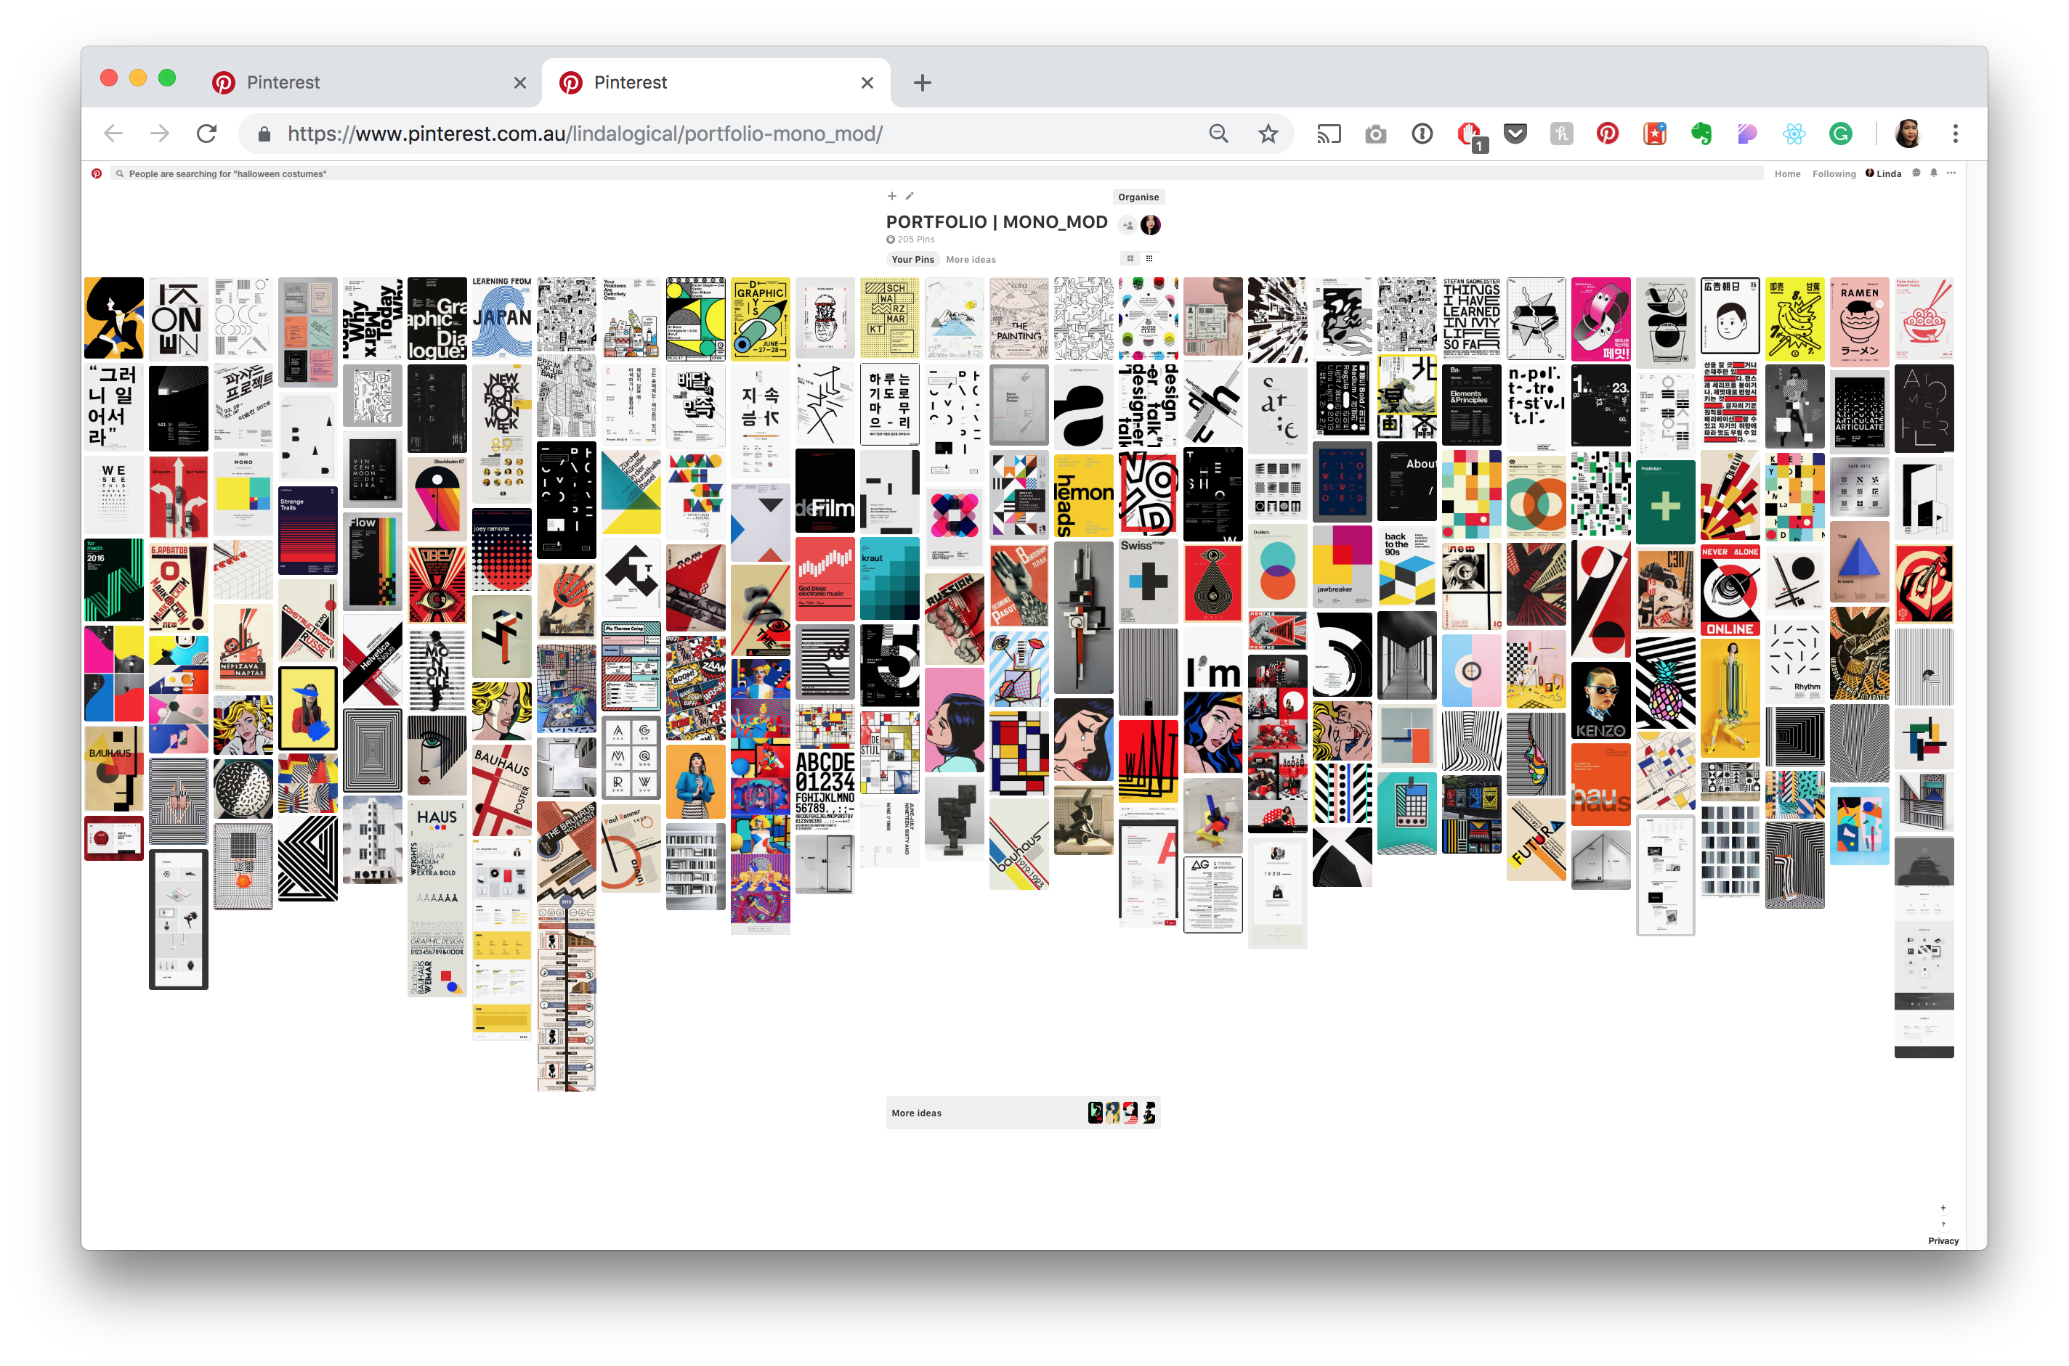
PINTEREST

Slide 4
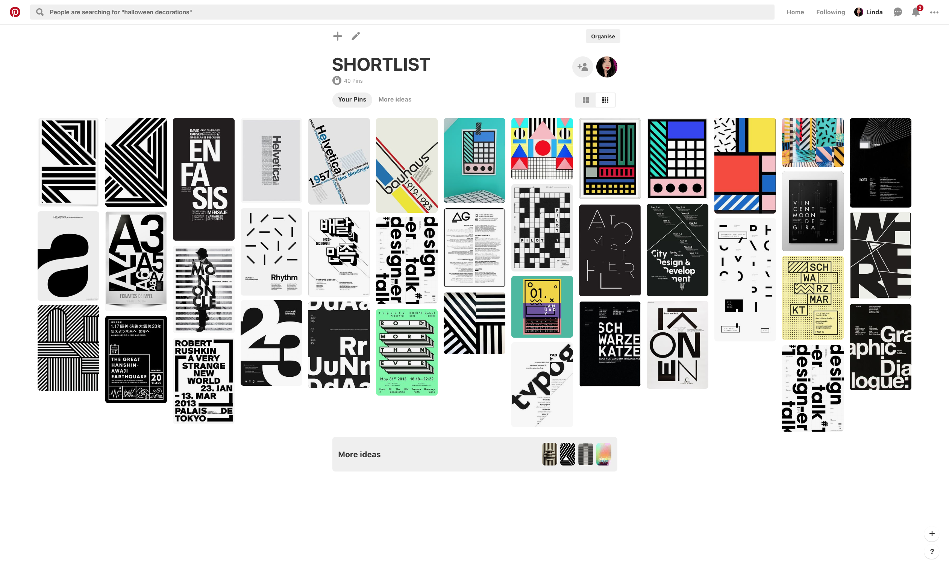
PINTEREST

Slide 5
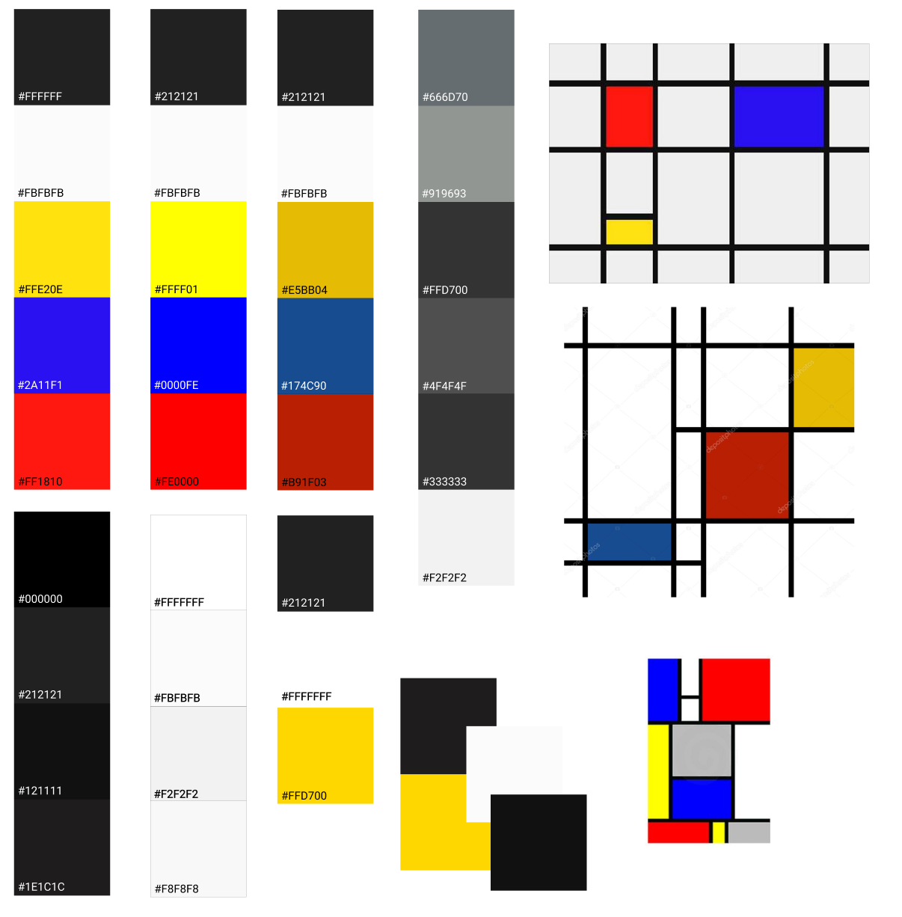
DESIGN
Mobile-First
Single-Page Scroll
Responsive
Monochrome
Primary Colours (Mondrian)
Typographic Heavy
Graphic and Geometric Shapes, Lines
CSS Grid

Slide 6
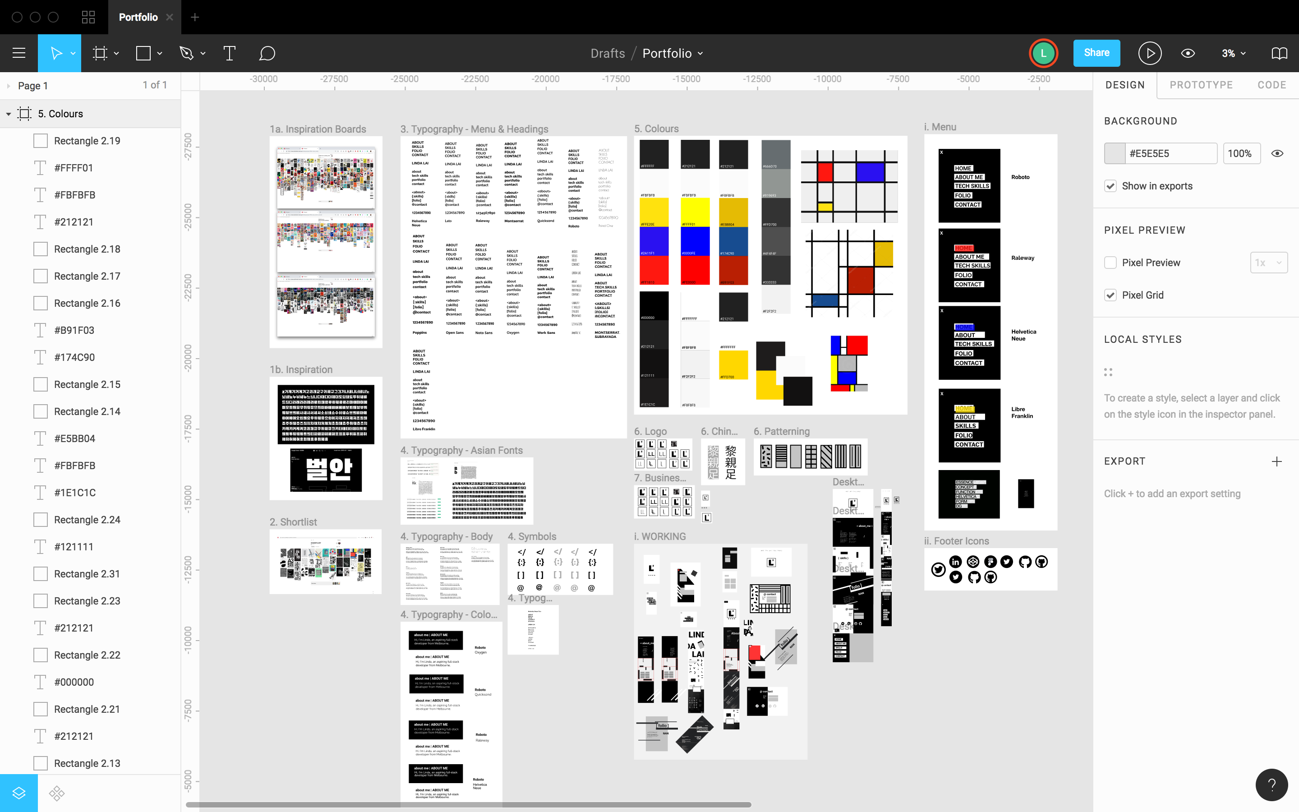
FIGMA

Slide 7
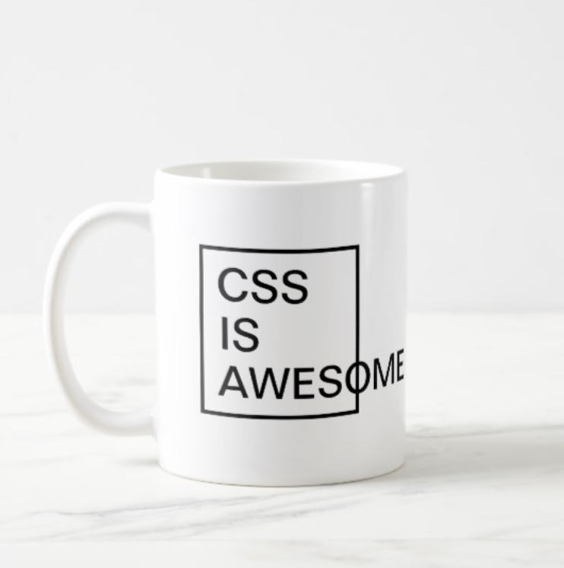
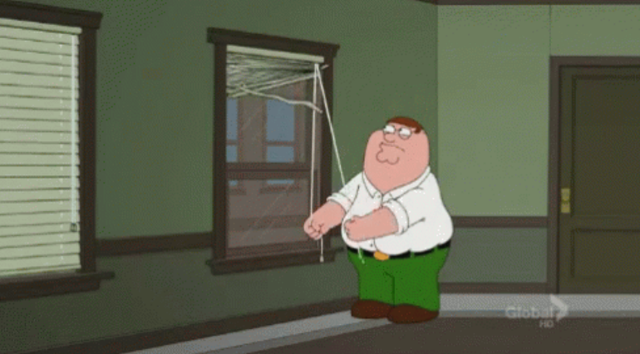
CHALLENGES
Trickiest: alignment and overflow acting in unexpected and puzzling ways - particularly challenging when trying to ensure that shapes, headlines and type didn't overlap whilst behaving responsively.
Longest: once the main layout and alignment were established, finding and adapting a responsive navigation menu bar and bringing together in finishing touches, minor animations, transitions and hover elements cohesively.

